Slide 1


Programming Syntax
A Comprehensive Guide to Coding Grammar for Beginners

Slide 2
Part 1: Data Storage
Understanding how computers memorize and organize information.

Slide 3


Variables: The Storage Boxes
A Variable is a reserved space in computer memory used to store a specific piece of data. Imagine it as a box with a label on the outside.
The Name: A unique label used to find the box later (e.g., playerName).
The Value: The data sitting inside the box (e.g., "Alex").
Reassignment: You can open the box and swap the contents at any time.

Slide 4
Strings: Handling Text
A String is any sequence of characters (letters, numbers, or symbols) treated as plain text data.
Quotation Marks: Always wrapped in " " or ' '.
Concatenation: Gluing strings together (e.g., "Super" + "man").
Analogy: Like a written note or a message scrawled on paper.

Slide 5

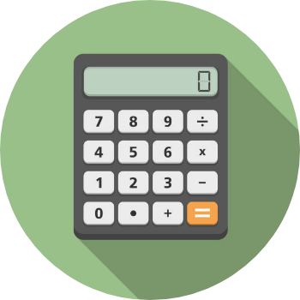
Integers: Counting Whole Items
Whole Numbers Only
An Integer is a numerical data type that does not allow decimal points or fractions. It is used for counting distinct items.
Analogy: Counting physical coins (you can't have half a coin in this context).
Usage: Levels, scores, lives, or years.
Example: let playerLives = 3;

Slide 6
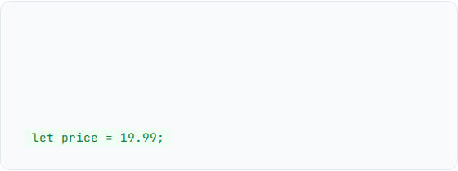
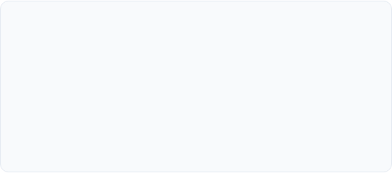
Floats: Precise Decimals
Why Floats?
Common Uses
Sometimes whole numbers aren't enough. Floats (and Doubles) allow for decimal precision, making them vital for math that requires accuracy.
Prices and currency.
GPS coordinates.
Scientific measurements.

Slide 7
Booleans: The Logic Gate
True or False?
1/0
A Boolean is a logical data type that can only hold one of two values: true or false.
Analogy: Like a light switch—it is either ON or OFF.
Usage: Is the user logged in? Is the game over?
Example: let isGameOver = false;

Slide 8
Part 2: Coding Behavior
Methods, parameters, and the actions your program performs.

Slide 9
Methods: Reusable Actions
If variables are "Nouns," then Methods (also called Functions) are the "Verbs." They are reusable blocks of instructions.
Reusability: Write code once, call it a thousand times.
Analogy: Like a specific recipe in a cookbook.
Example: jumpPlayer();

Slide 10
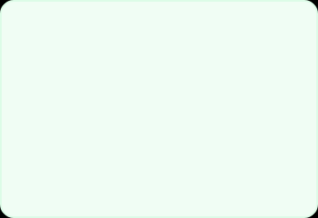
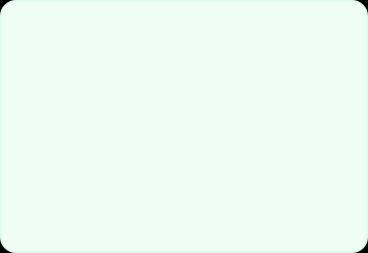



Parameters: Method Inputs
Raw Materials
Processing
Example
Parameters are the data inputs you pass into a method so it can do its job.
The code inside the method uses these variables to calculate a unique result.
add(5, 10); The numbers 5 and 10 are the parameters.

Slide 11
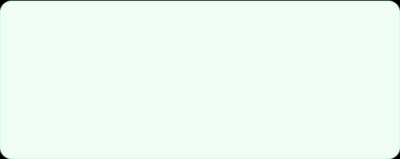
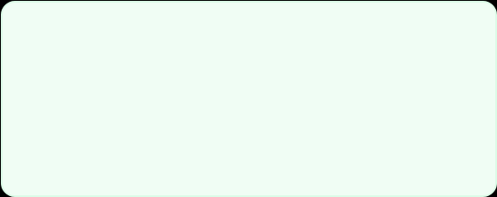


Return Values: Final Output
The Answer
Ending the Action
The Return Value is the final output sent back to the main program.
Once a method returns a value, its job is done and it stops executing code.

Slide 12
Life of a Method Call
1. Call
2. Pass
3. Exec
4. Return
The program invokes the method by its unique name.
Parameters (data inputs) are sent inside.
The computer runs the instructions line by line.
The final answer is sent back to the program.

Slide 13
Summary & Analogies Cheat Sheet
Concept | Definition | Real-World Analogy
String | Sequence of text characters | A written note
Integer | Whole numbers (no decimals) | Counting coins
Boolean | True/False values | A light switch
Method | Reusable block of actions | A recipe in a book

Slide 14

Any Questions?
Thank you for your attention! Happy Coding!
Source: learn-programming-syntax.io

